Slide 1
Contiguous Storage

Slide 2
Objectives
How do you manage group data efficiently?
Store
Input
Output
Search
Sort

Slide 3
Contents
Introduction to contiguous storage
Arrays
One-dimensional Arrays
Declaration
Memory Allocation
Initialization
Accessing elements
Traversing
1-D Arrays are parameters of functions
Searching
Sorting
2-D Arrays
User-defined Data Type: Structure

Slide 4
1- Contiguous Storage
Commonly, a set of the same meaning elements are considered.
They are stored in a contiguous block of memory.
Ex: Group of 10 int numbers → 40 bytes block is needed.
Data are considered can be a group of some items which belong to some different data types → Contiguous memory block is partitioned into some parts which have different size, one part for an item.
Data structure: A structure of data stored.
Array is the simplest data structure which contains some items which belong to the sane data type.
Common used operations on a group: Add, Search, Remove, Update, Sort

Slide 5
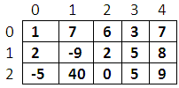
2 - Array
An array is a data structure consisting of an ordered set of elements of common type that are stored contiguously in memory. Each element is identified by it’s position (index).
index
0
1
2
3
4
5
6
7
8
9
a (array)
5
4
8
15
90
27
34
21
152
80
value
a[3]
element
a[i] is an integer
column
Dimension: Direction that is used to perform an action on array.
Number of dimensions: Number of indexes are used to specify an element.
Common arrays: 1-D and 2-D arrays.
Name of an array: An array has it’s name.
m
m[1][3]
row

Slide 6
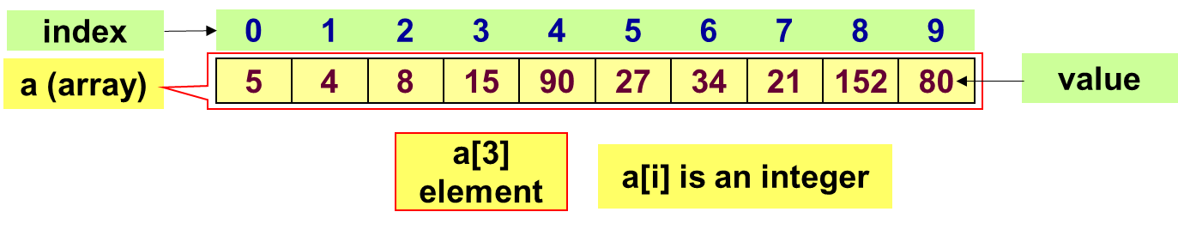
3 - One-dimensional Arrays (1-D)
1-D array: a collection of items (elements, terms) which belong to the same data type and are stored contiguously in memory.
Each element has a unique index and holds a single value. Index numbering starts at 0 and extends to one less than the number of elements in the array.
To refer to a specific element, we write the array name followed by bracket notation around the element's index. Example: identifier[index]
1-D array structure:

Slide 7
1-D Array: Declaration
If the array is stored in the stack segment → Use a STATIC array → The compiler will determine the array’s storage at compile-time.
Syntax:
Example:
int a1[5]; char s[12]; double a2[100];
How compilers can determine the memory size of an array?
=> NumberOfElements * sizeof(dataType) → int a1[5] → 5 *sizeof(int) = 5*4 = 20 bytes
DataType ArrayName[NumberOfElements];

Slide 8
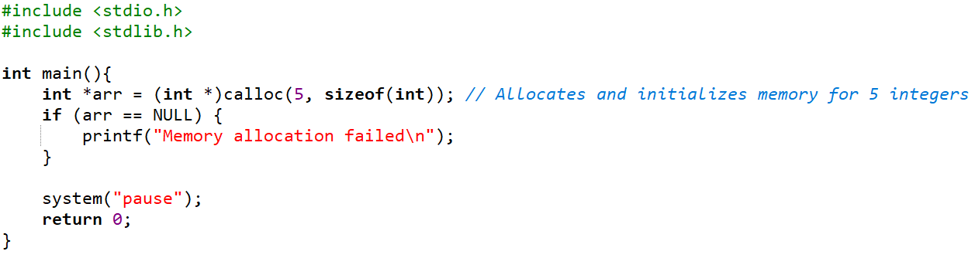
1-D Array: Declaration (cont.)
If the array is stored in the heap → Use a pointer (DYNAMIC array) → The array’s storage will be allocated in the heap at run-time through memory allocating functions (malloc, calloc, realloc)
Example:

Slide 9
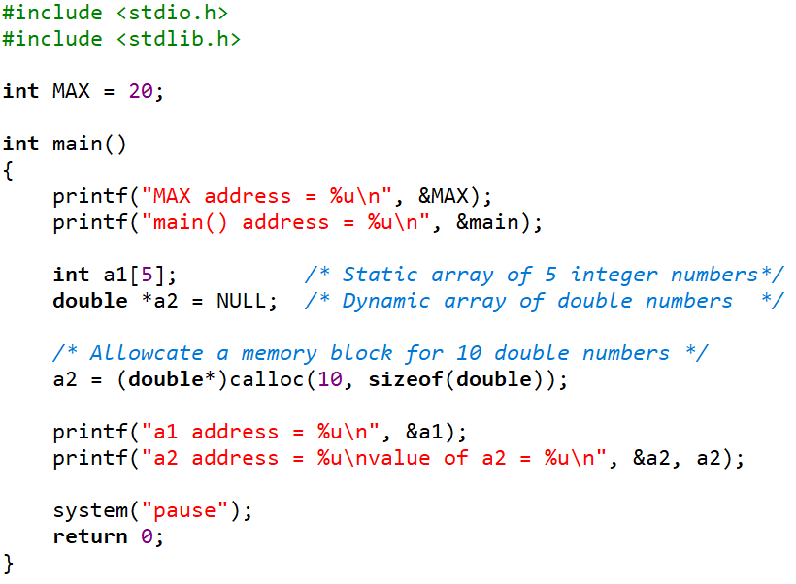
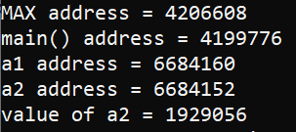
1-D Array: Example Memory Allocation
Data segment
42026608
20
Code segment
Code of main()
4199776
HEAP
80 bytes
1929056
STACK
segment
20 bytes
6684160
6684152
1929056

Slide 10
1-D Arrays: Initialization & Accessing Elements
Initialize an array:
How to access the i^{th} element of the array a?
a is the address of the first element. Based on operation on pointers:
→ a+i : address of the i^{th} element, another way: &a[i]
→ *(a+i): value of the i^{th} element, another way: a[i]
DataType a[] = {value1, value2, … };

Slide 11
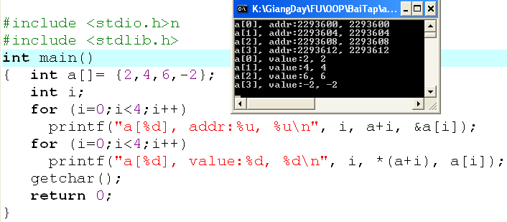
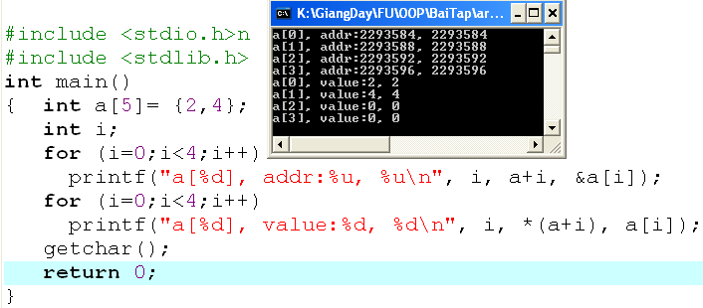
1-D Arrays: Initialization & Accessing Elements (cont.)
Compiler will automatically count number of initial values to determine the size of array memory
The size of array memory is
pre-defined.
Compiler will fill 0 to elements which are not initialized.
int a[5];
Elements contain un-predictable values because they are local variables.
TEST IT !!!!

Slide 12
1-D Arrays: Traversing
A way to visit each element of an array
Suppose that the 1-D array, named a, containing n elements.
Forward traversal:
Backward traversal:
int i;
for (i=0; i<n; i++){
[if (condition)] Access a[i];
}
int i;
for (i=n-1; i>=0; i--){
[if (condition)] Access a[i];
}

Slide 13
1-D Array is a Function Parameter
The array parameter of a function is the pointer of the first element of the array.
Example 1:
Input an array of n integers → void input (int* a, int n)
Example 2:
Input elements of an array of integers which it’s number of element is stored at the pointer pn → void input (int a[], int*pn)
Example 3:
Calculate the sum of an array of n integers → int sum (int *a, int n)
Example 4:
Output an array of n double numbers → void output (double a[], int n)

Slide 14
1-D Array is a Function Parameter: Demo
Demo 1: Develop a C-program that will:
Accept values to an integer array that may contain 100 elements.
Print out the it’s maximum value.
Print out it’s elements.
Print out it’s even values.
Hint:
Verbs:
Begin
Input n (one value)
Input a, n (function)
maxVal = get maximum value in a, n (function)
Print out maxVal (one value)
Print out a, n (function)
Print even values in a, n (function)
End
Nouns:
Constant: MAXN=100
Static array of integers → int a[MAXN]
Real number of elements → int n
Maximum value → int maxVal.

Slide 15
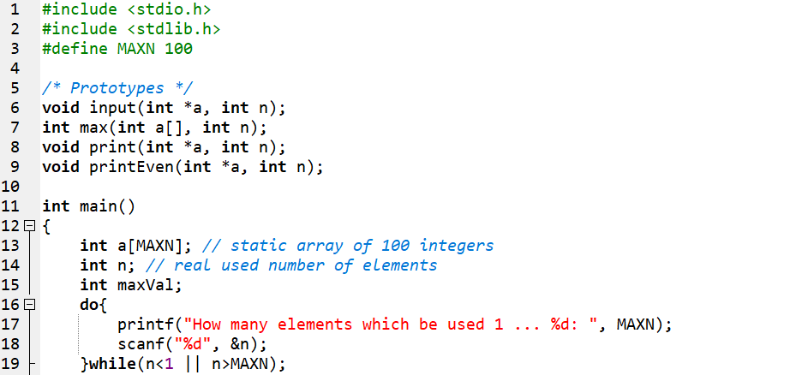
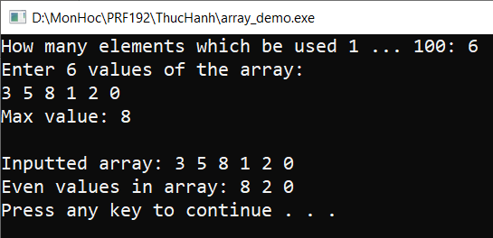
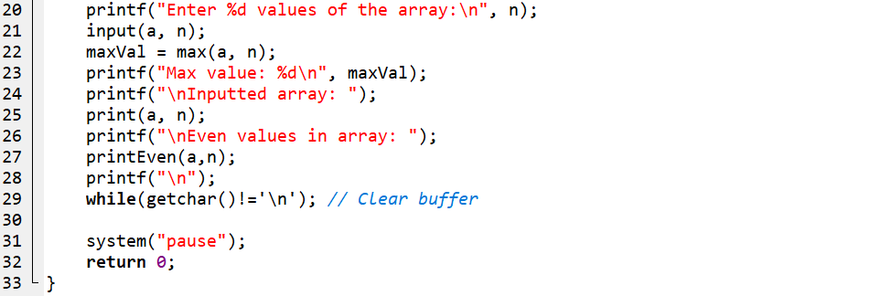
Array Funtion Parameter: Demo 1 (cont.)

Slide 16
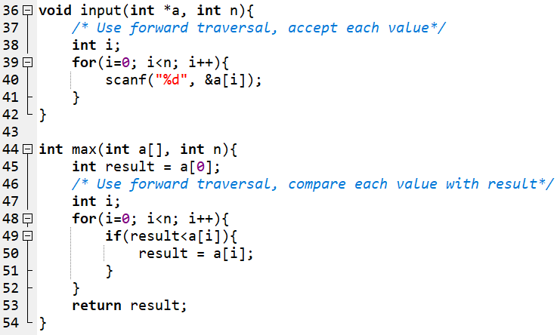
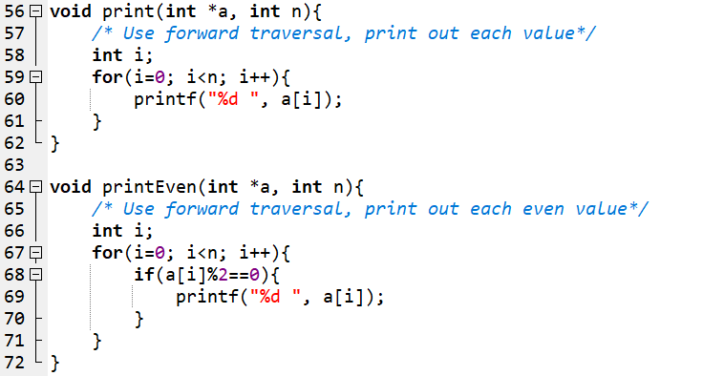
Array Funtion Parameter: Demo 1 (cont.)

Slide 17
Array Function Parameter: Demo 1
Problems:
If you allocate an array having 100 elements but 6 elements are used then memory is wasted.
If you allocate an array having 100 elements but 101 elements are used then there is a lack of memory.
Solution:
Use a dynamic array
Can expand the size of the original array

Slide 18
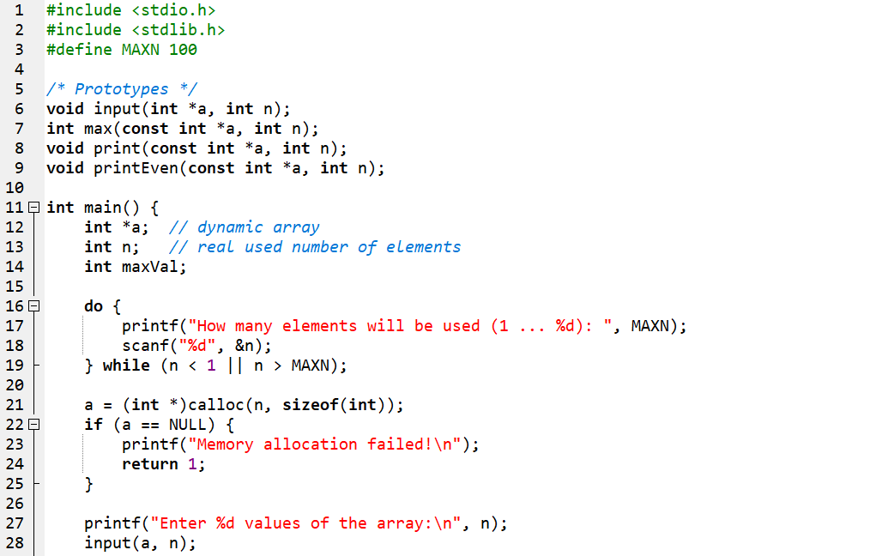
Array Funtion Parameter: Solution
Use Dynamic Array

Slide 19
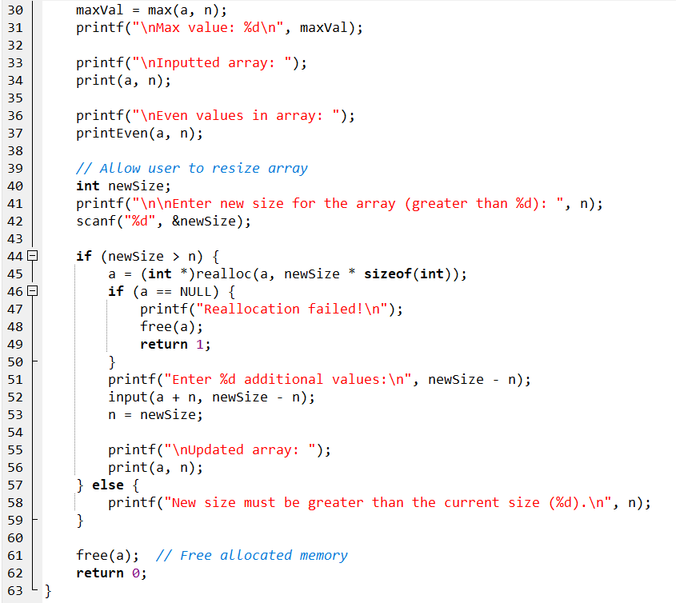
Solution (cont.)
Expand the size of the original array

Slide 20
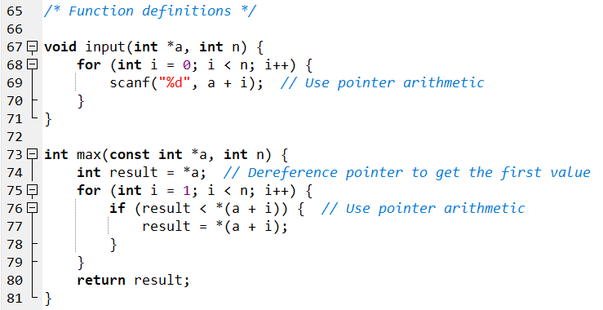
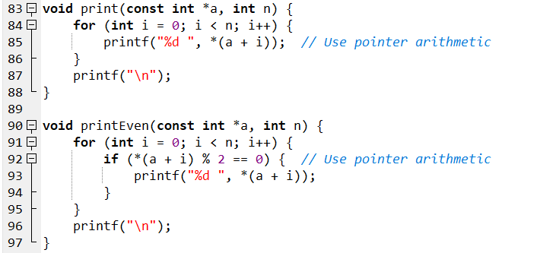
Solution (cont.)

Slide 21
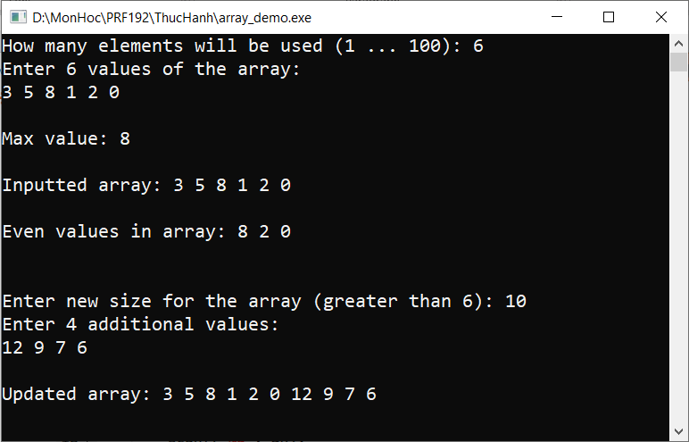
Output Solution

Slide 22
Exercise 1:
Develop a C-program that will:
Accept values to an integer array that may contains 100 elements. The input will terminate when user enters the value of zero.
Print out the it’s maximum value.
Print out it’s elements.
Print out it’s even values.
Requirement:
The difference between this problem with the previous one is the input operation can terminate abruptly when 0 is accepted.
Memory block of the array needs to be allocated in excess
The function for input values of the array must be modified for this case and the number of elements is updated after each valid value is accepted.

Slide 23
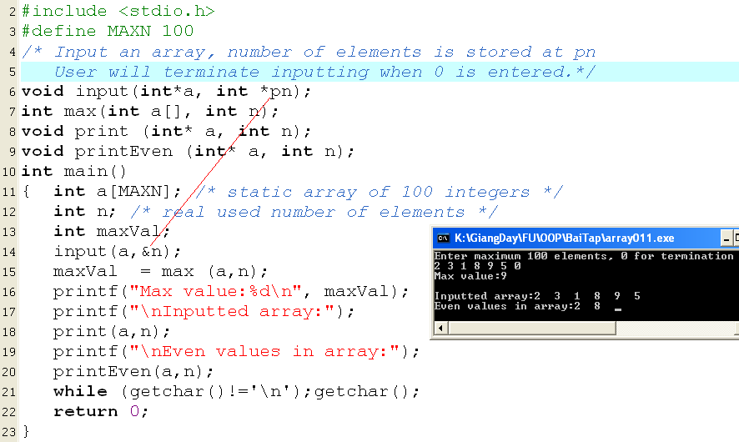
Exercise 1 (cont.)

Slide 24
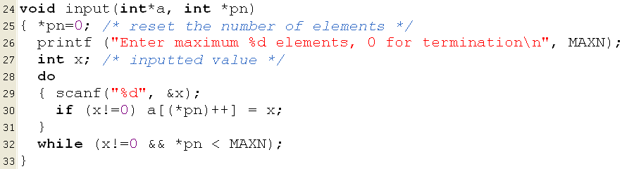
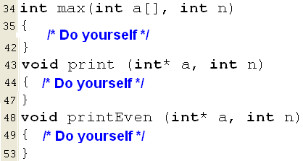
Exercise 1 (cont.)
x=3
n=0 → 1
0
3
x=7
n=3→ 4
0 | 1 | 2
3 | 5 | 2

Slide 25
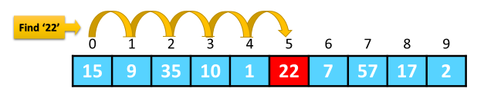
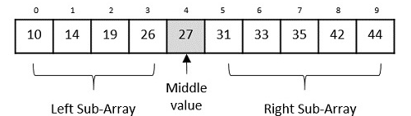
1-D Arrays: Searching
A search algorithm finds the record of interest using the key array.
Return value: The positional index at which the interest value is found.
Two common search algorithms are:
Linear search | Binary search

Slide 26
Searching: Linear Search
Linear Search: Find the position of the value x in the array a having n elements.
Search the value of 6 in the array a having 8 items.
5 | 9 | 2 | 7 | 6 | 5 | 2 | 5
i=0 | 1 | 2 | 3 | 4
Search the value of 12 in the array a having 8 items.
5 | 9 | 2 | 7 | 6 | 5 | 2 | 5
i=0 | 1 | 2 | 3 | 4 | 5 | 6 | 7
-1
int firstLinearSearch(int x, int a[], int n)
{
int i;
for ( i=0; i<n; i++)
if ( x == a[i] ) return i;
return -1;
}
int lastLinearSearch(double x, double *a, int n)
{
int i;
for ( i=n-1; i>=0; i--)
if ( x == a[i] ) return i;
return -1;
}

Slide 27
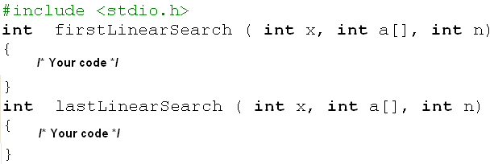
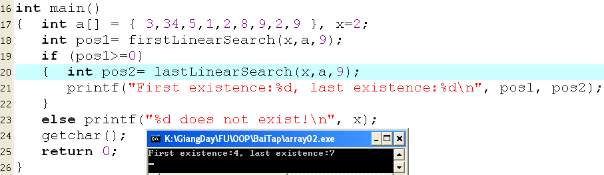
Exercise 2: Using Linear Search algorithm
Do yourself

Slide 28
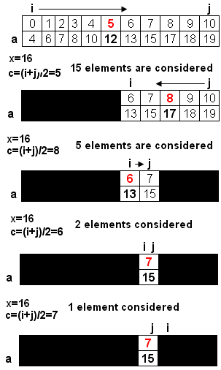
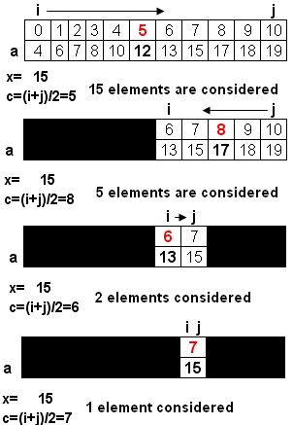
Searching: Binary Search
Binary Search: Condition for application: Values in the array were sorted.
int binarySearch ( int x, int a[], int n)
{
int i=0, j= n-1, c ;
while (i<=j)
{
c= (i+j)/2;
if ( x== a[c] ) return c ;
if (x < a[c] ) j = c-1;
else i = c +1;
}
return -1;
}
return c (7)
i>j → return -1

Slide 29
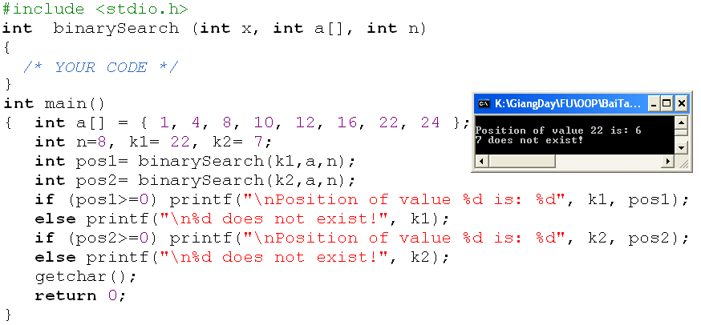
Exercise 3: Using Binary Search algorithm
No. of elements considered | No. of comparisons
n= 2^{m} | 1
2^{m-1} | 1
2^{m-2} | 1
… | …
2⁰ | 1
Sum | m+1 = log₂(n) +1
Evaluation:

Slide 30
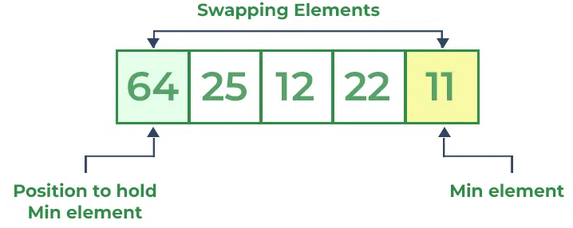
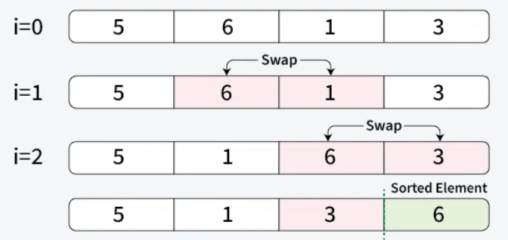
1-D Arrays: Sorting
Sorting: Changing positions of elements in an array so that values are in a order based on a pre-defined order relation.
Default order relation in set of numbers: Value order
Default order relation in a set of characters/ strings: Dictionary order
Only two sorting algorithms are introduced here.
Selection sort | Bubble sort

Slide 31
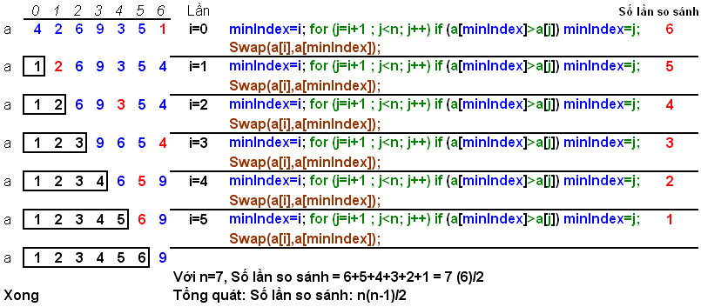
Sorting: Selection Sort
Find the minimum value in the list
Swap it with the value in the first position
Repeat the steps above for remainder of the list

Slide 32
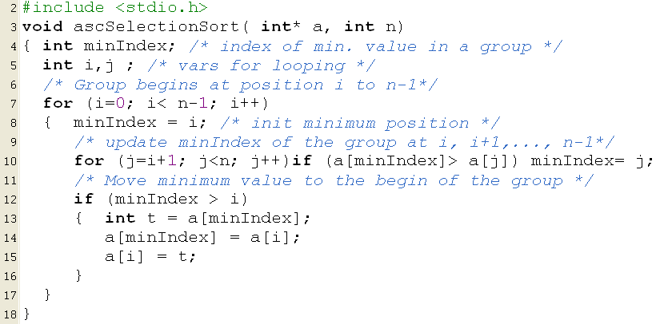
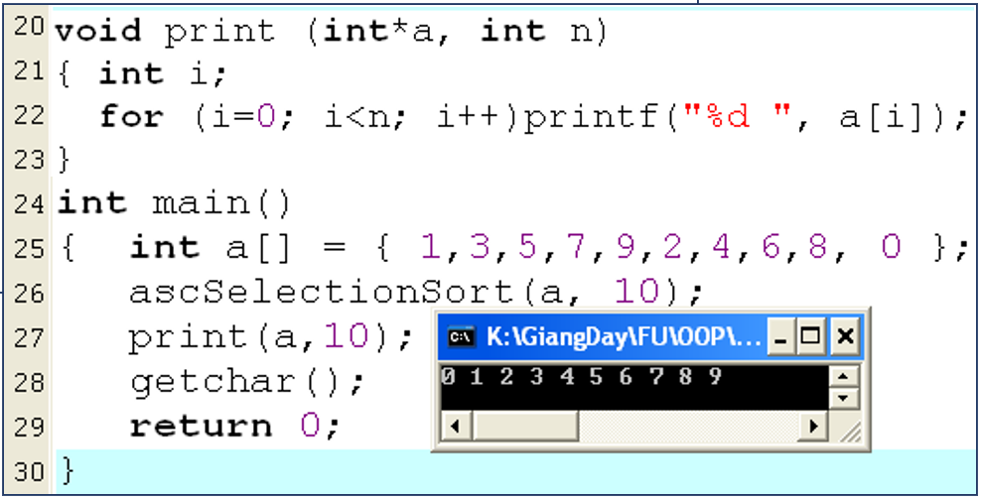
Selection Sort: Students complete the demo

Slide 33
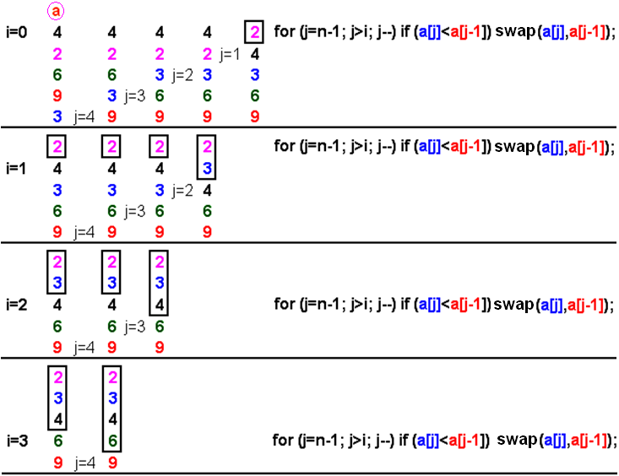
Sorting: Bubble Sort
It works by repeatedly stepping through the list to be sorted, comparing two items at a time and swapping them if they are in the wrong order.
The pass through the list is repeated until no swaps are needed, which means the list is sorted

Slide 34
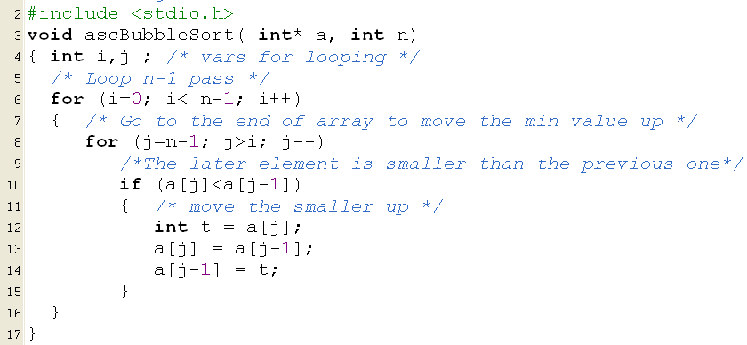
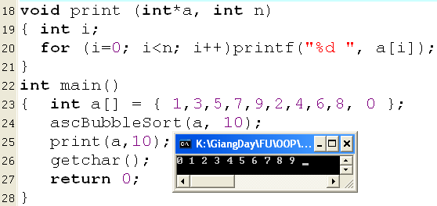
Bubble Sort: Demo

Slide 35
1-D Arrays: A Case Study
Develop a C-program that helps user managing an 1-D array of integers (maximum of 100 elements) using the following simple menu:
1- Add a value
2- Search a value
3- Remove the first existence of a value
4- Remove all existences of a value
5- Print out the array
6- Print out the array in ascending order (positions of elements are preserved)
7- Print out the array in descending order (positions of elements are preserved)
Others- Quit

Slide 36
Case Study: Problem Analyze
In this program, user can freely add or remove one or more elements to/ from the array. So, an extra memory allocation is needed (100 items).
Data:
Array of integers int a[100], n
Searched/added/removed number → int value

Slide 37
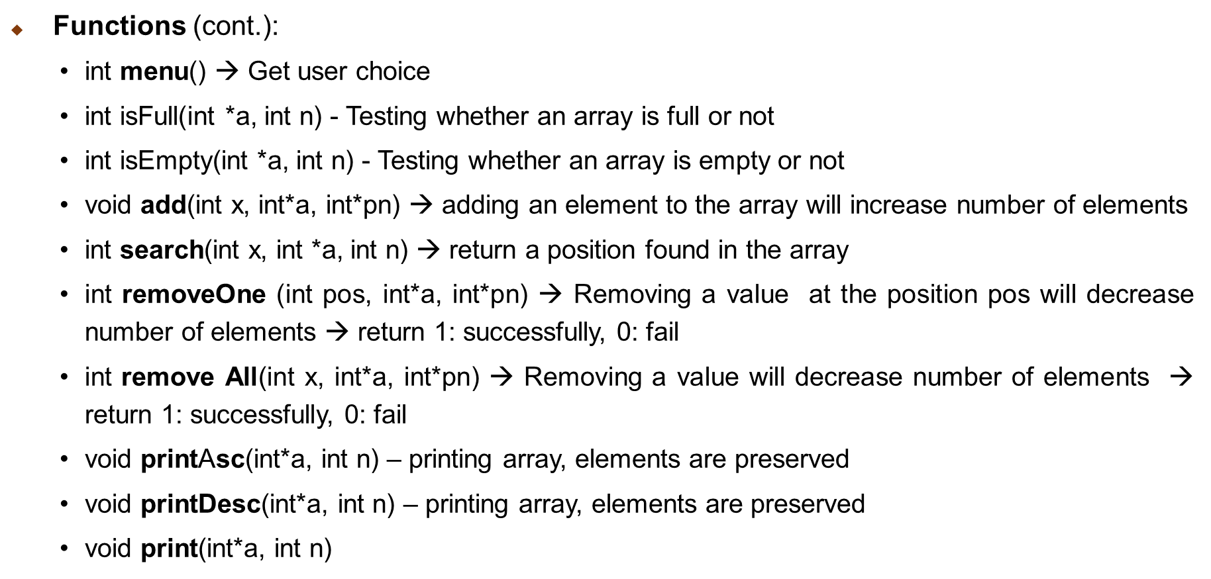
Case Study: Problem Analyze (cont.)

Slide 38
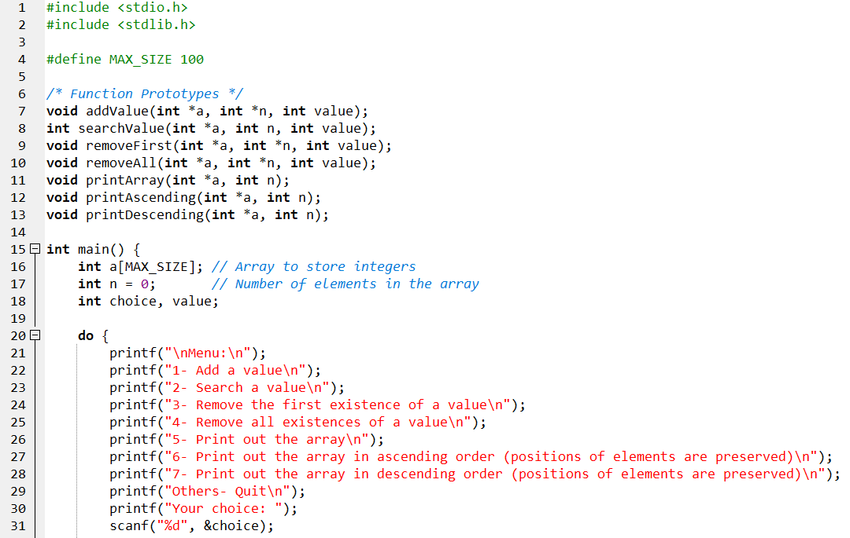
Case Study: Code Design

Slide 39
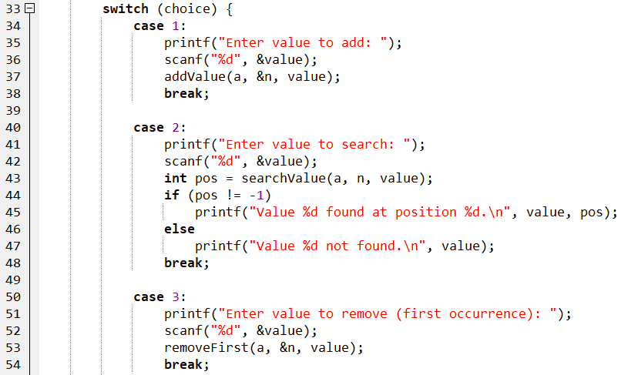
Case Study: Code Design

Slide 40
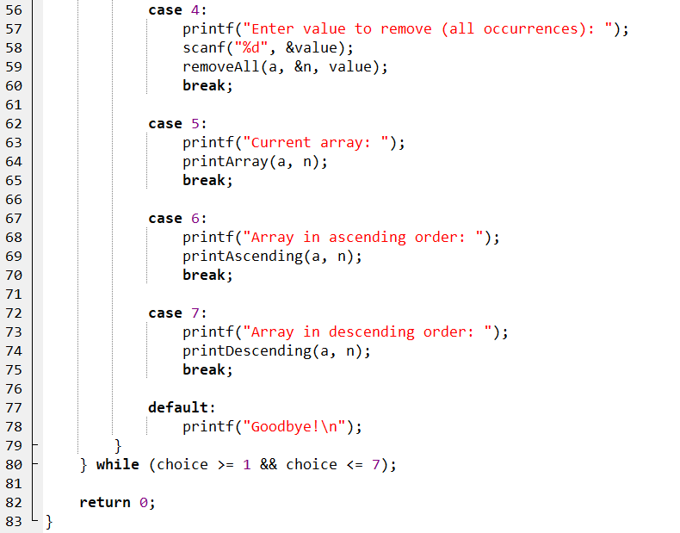
Case Study: Code Design

Slide 41
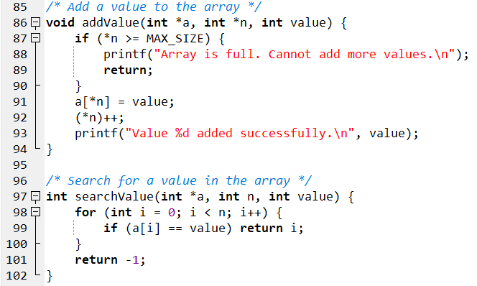
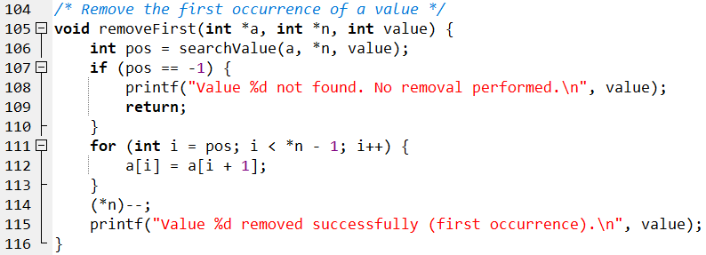
Case Study: Code Design

Slide 42
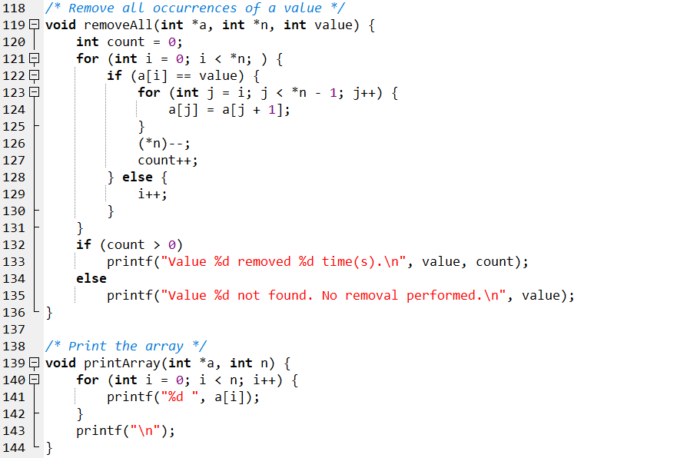
Case Study: Code Design

Slide 43
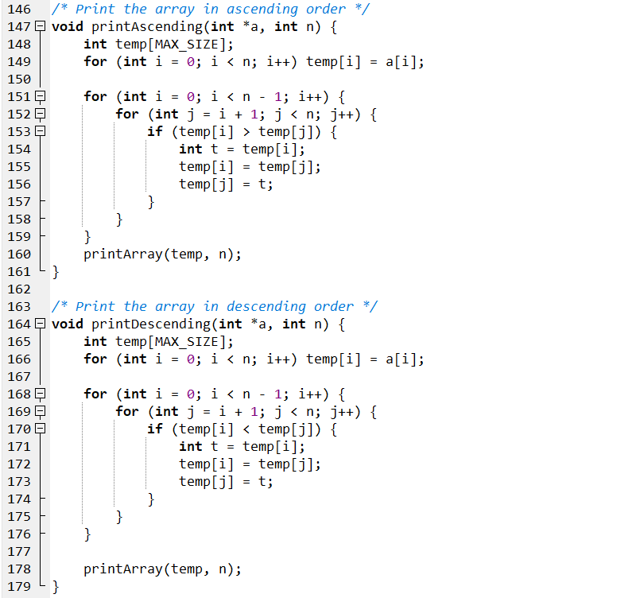
Case Study: Code Design

Slide 44
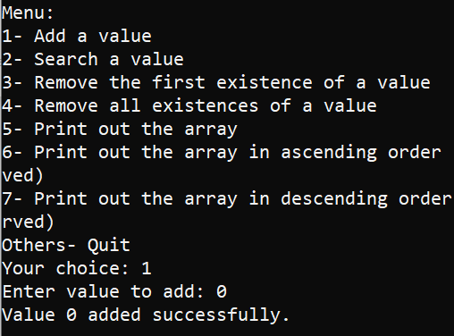
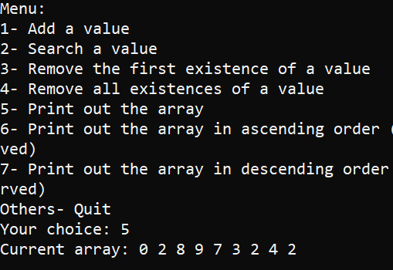
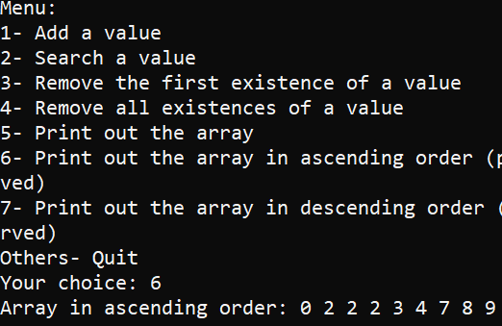
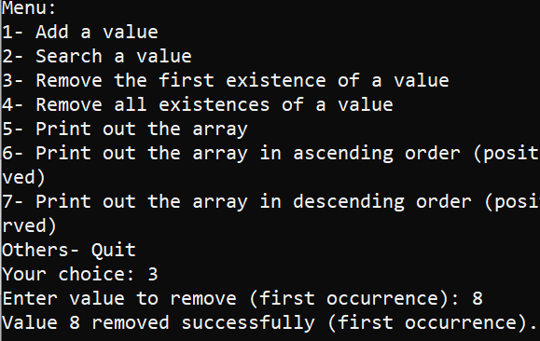
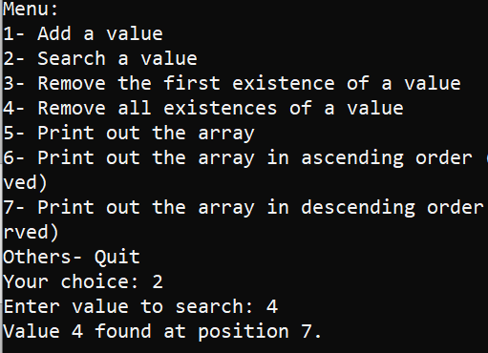
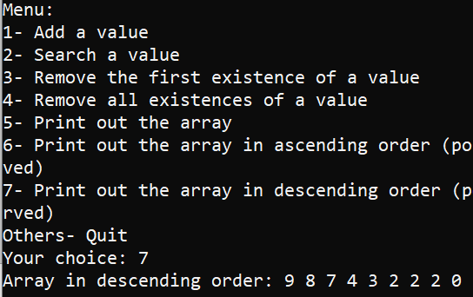
Compile & Run
Input: 9 integer numbers
Print all elements
Print the array in ASC order
Remove the first exist of value
Search a value
Print the array in DESC order

Slide 45
Exercise 4:
Develop a C-program that helps user managing an 1-D array of real numbers (maximum of 100 elements) using the following simple menu:
1- Add a value
2- Search a value
3- Print out the array
4- Print out values in a range (minVal<=value<=maxVal, minVal and maxVal are inputted)
5- Print out the array in ascending order (positions of elements are preserved)
Others- Quit

Slide 46
4 - Two-Dimensional Arrays
A group of elements which belong the same data type and they are divided into some rows and some column (it is called as matrix also).
Each element is identified by two indexes (index of row, index of column).
Traversing a matrix:
for ( i =0; i<row; i++)
{
for ( j=0; j< column; j++)
[if (condition)] Access m[i][j];
}
column
m
m[1][3]
row

Slide 47
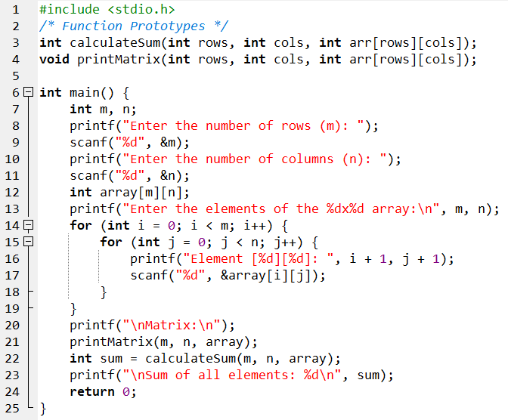

Two-Dimensional Arrays: Example

Slide 48

Two-Dimensional Arrays: Example (cont.)

Slide 49
Summary
Array is the simplest data structure for a group of elements which belong to the same data type.
Each element in an array is identified by one or more index beginning from 0.
Number of dimensions: Number of indexes are used to identify an element.
Static arrays → Stack segment
DataType a[MAXN];
DataType m[MAXROW][MAXCOL];
Dynamic array: Use pointer and allocate memory using functions
double *a = (double*)calloc(n, sizeof(double));
int** m = (int**) calloc(row, sizeof(int*));
for (i=0; i<row; i++) m[i]= (int*)calloc(col, sizeof(int));

Slide 50
Summary
Accessing elements in an array:
Common operations on arrays:
Add an element
Search an element
Remove an element
1-D Array (a) |  | 2-D Array (m)
Address | Value | Address | Value
&a[index] | a[index] | &m[i][j] | m[i][j]
a+index | *(a+index)
Compiler determines the address of an element:
a + index*sizeof(DataType) |  | m + (i*NumCol + j)*sizeof(DataType)
Input
Output
Sort

Slide 51
Structures

Slide 52
Objectives
After studying this section, you should be able to:
What is C structure?
When to use structures.
Syntax of a structure.
How to declare variable of type structure?
Fields of a structure and how to initialize them.
How to manipulate structure type

Slide 53
Contents
Structure Definition
Struct Syntax
Manipulating Structure Types
Arrays of Structures
Function with a Structure Input Parameter

Slide 54
1. Structure Definition
The structure in C is a user-defined data type that can be used to group items of possibly different types into a single type.
Structures are also called records.
The struct keyword is used to define the structure in the C programming language.
Unlike arrays, a struct is composed of data of different types.
You use structures to group data that belong together.
Additionally, the values of a structure are stored in contiguous memory locations.

Slide 55
Structure Definition (cont.)
Examples:
Data elements in a structure are called fields or members.
Complex data structures can be formed by defining arrays of structs.
Student information: - student id, - last name, - first name - major, - gender, … | Bank account information: - account number, - account type - account holder + first name + last name - balance

Slide 56
2. Struct Syntax
Syntax of the structure type:
typedef struct{
dataType1 field1;
dataType2 field2;
…
} structName;
struct structName{
dataType1 field1;
dataType2 field2;
…
};
Or

Slide 57
Syntax Structure (cont.)
Examples:
How to declare variable of type structure?
Example: eventDate ev; person p; telephone tel;
Example 1 | Example 2 | Example 3
typedef struct { int day; int month; int year; } eventDate; | typedef struct { char name[20]; int age; } person; | struct telephone { char name[30]; int number; };
structName variableName;

Slide 58
3. Manipulating Structure Types
How to access a field in a structure:
Use the direct component selection operator, which is a period ‘.’
The ‘.’ operator has the highest priority in the operator precedence.
Example:
Structure assignment:
The copy of an entire structure can be easily done by the assignment operator.
Each component in one structure is copied into the corresponding component in the other structure.
person p1;
p1.name;
p1.age;

Slide 59


Example 1: Structure Type

Slide 60


Example 2: Structure Type

Slide 61
4. Arrays of Structures
We can also declare an array of structures.
Recall the syntax of an array: dataType array_name[size];
dataType can any C type including struct type
The array of structures can be simply manipulated as arrays of simple data types.
Example:
Write a program to organize information, includes: name and age of three family members. Print out the information for all members on each line.

Slide 62


Example 1: Array of Structures
family | name | age
family[0] | John | 30
family[1] | Sara | 28
family[2] | David | 2
family[1].age
family[2].name

Slide 63
5. Function with a Structure Input Parameter
When a structure variable is passed as an input argument to a function, all its component values are copied into the local structure variable.
Syntax:
Example:
Write a C program to print a student's information including: id, name, age. Use a structure to define the student's data structure and use a function with a parameter of type structure to print the information.
dataType functionName(structName parameter){ … }

Slide 64


Function with a Structure Input Parameter: Example 2

Slide 65
Case Study:
Write a C program that allows users to manage account information of up to 100 customers. Customer account information includes: accountNumber (int); accountType (char[20]); accountHolderName (char[40]); balance (double).
Requirements:
Enter customer account information from the keyboard
Print out a list of customer account information
Find and print out information on customers with a balance greater than $1000

Slide 66


Case Study: Code design

Slide 67

Case Study: Code design

Slide 68

Case Study: Code design

Slide 69

Case Study: Compile & Run

Slide 70
Summary
Understanding what a Structure type is?
When to use a Structure type in a program
How to define a Structure type and use a Structure in a program
Know how to work with the components of a Structure

